Slide 1
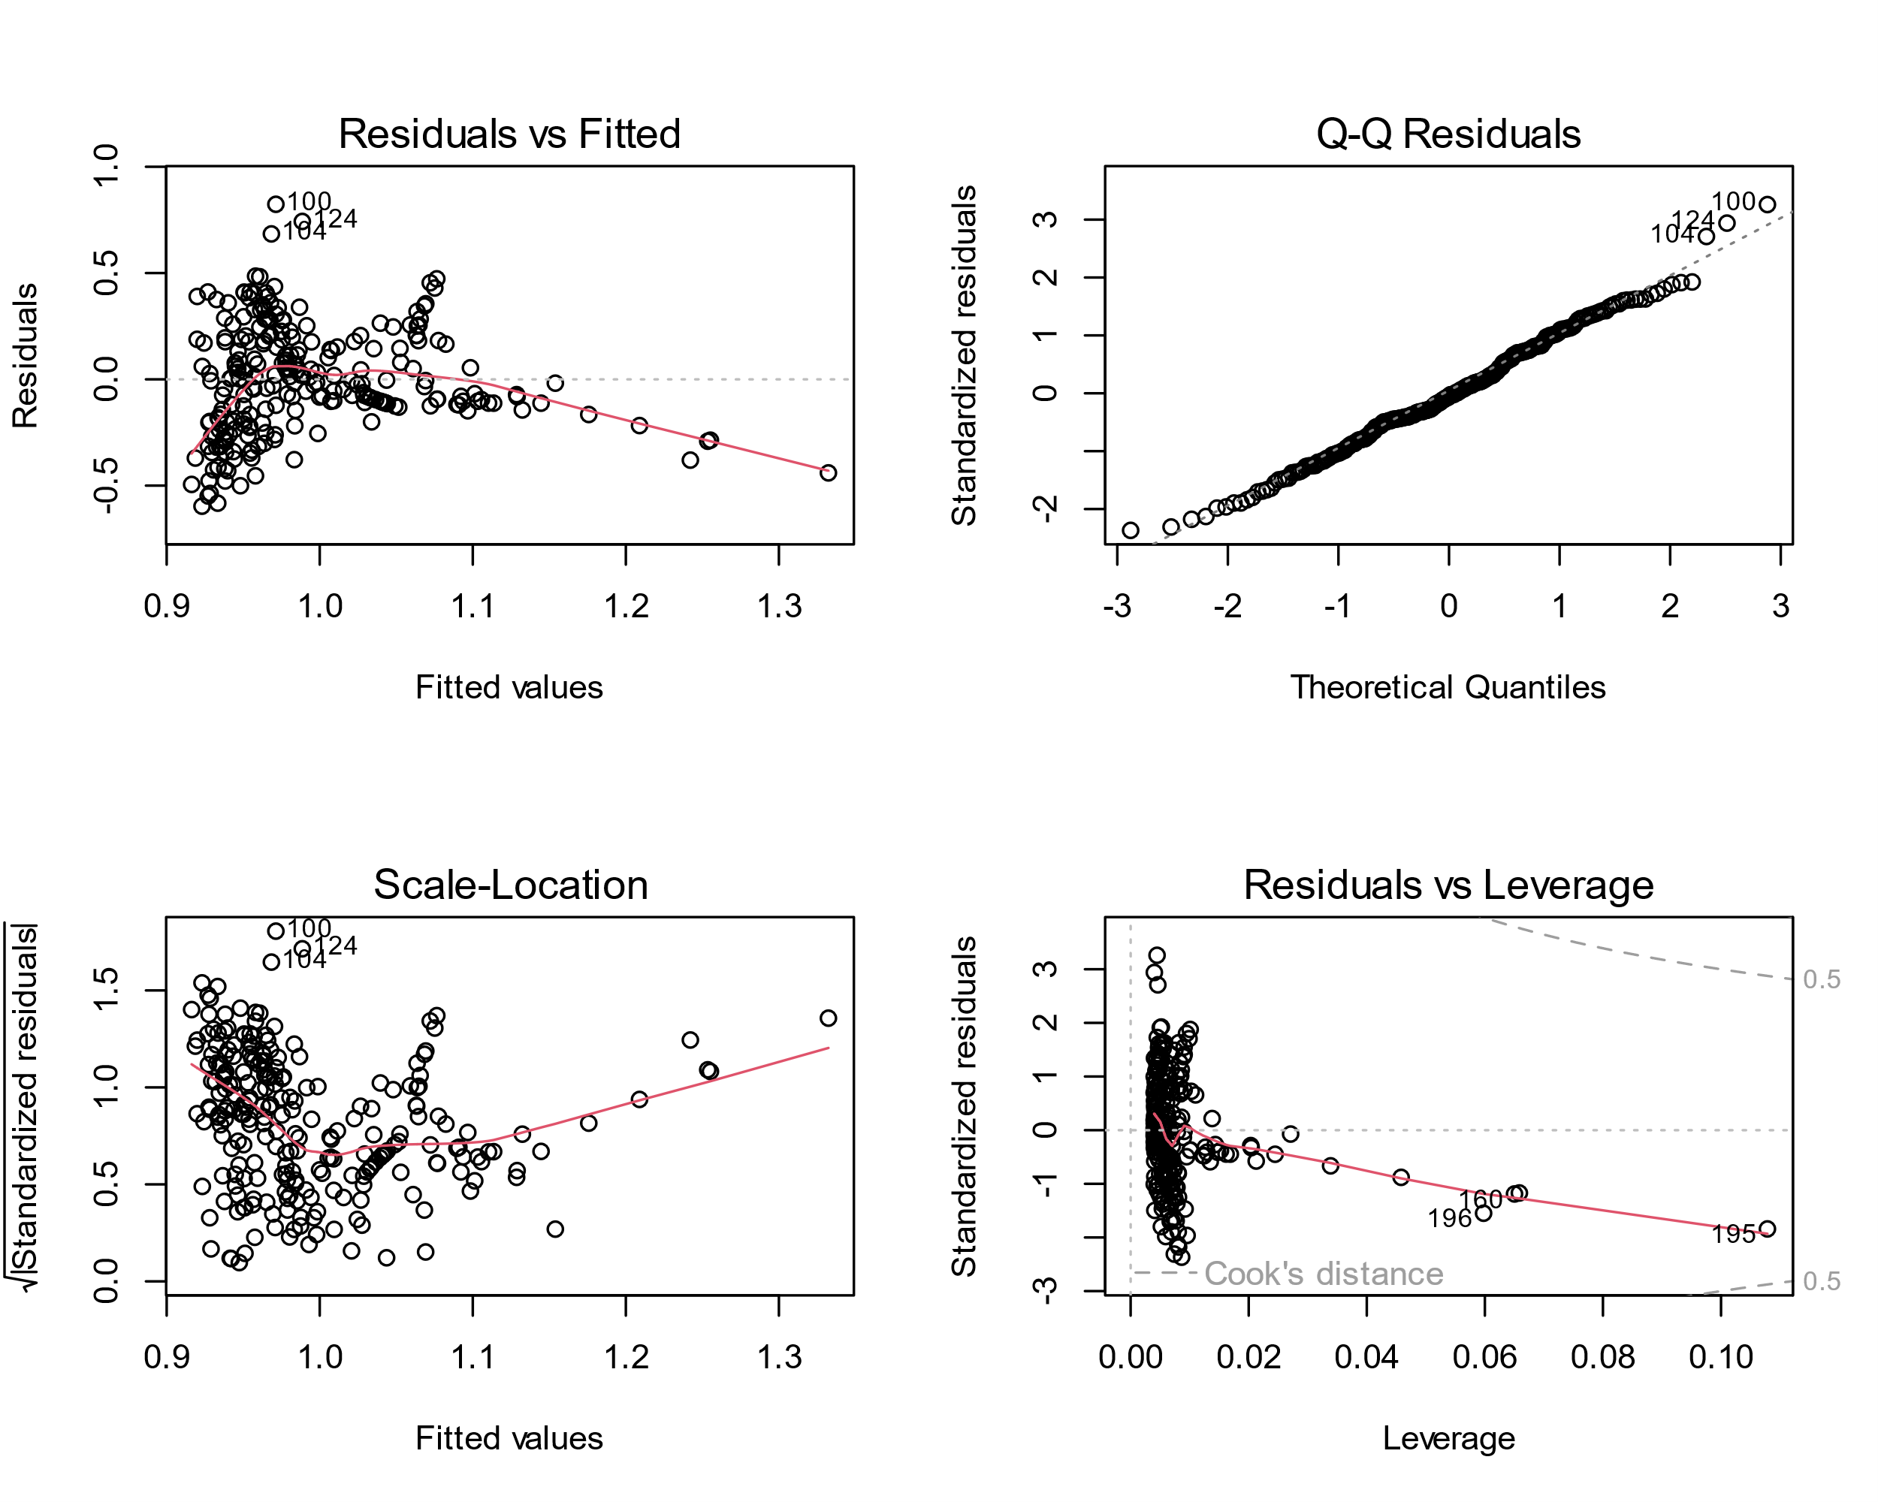
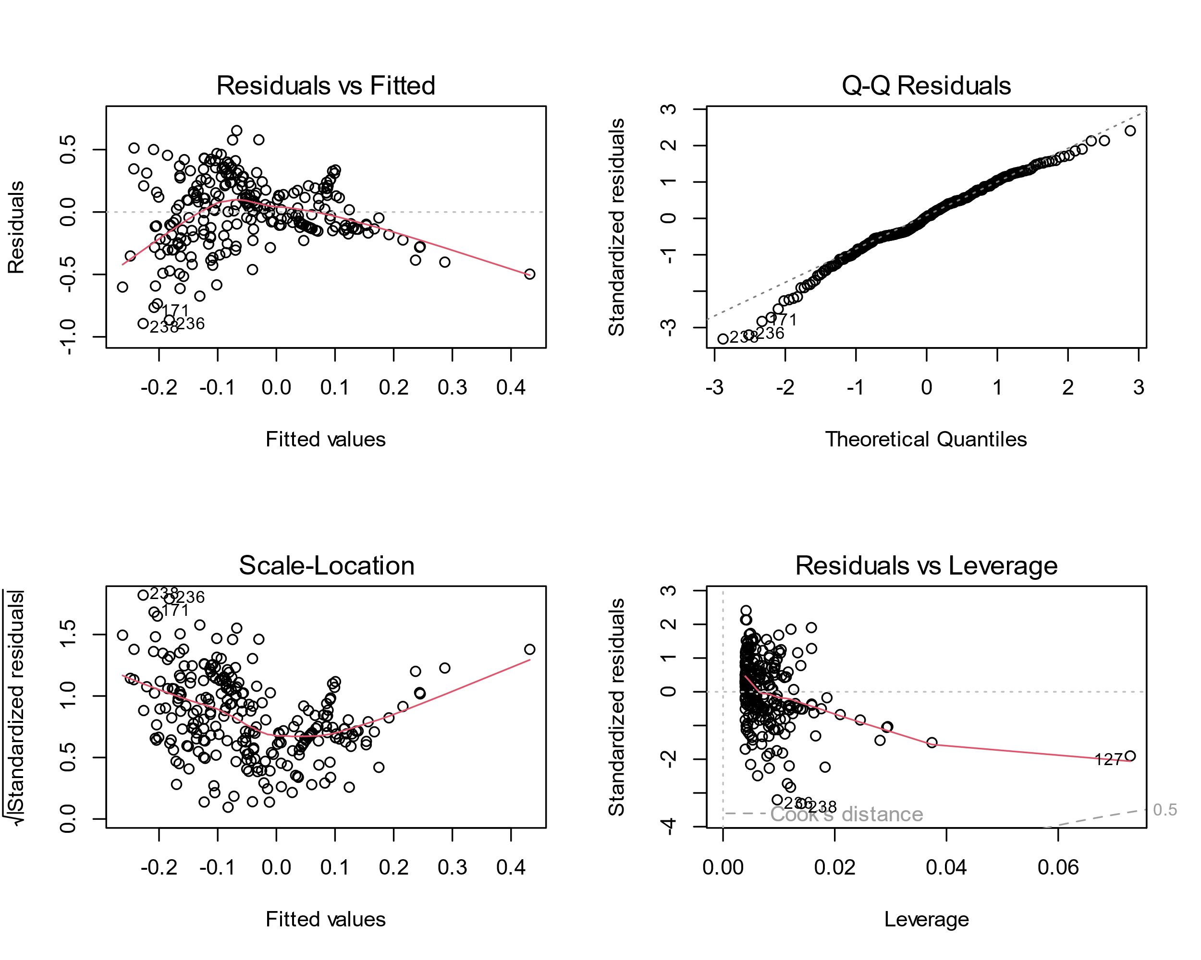
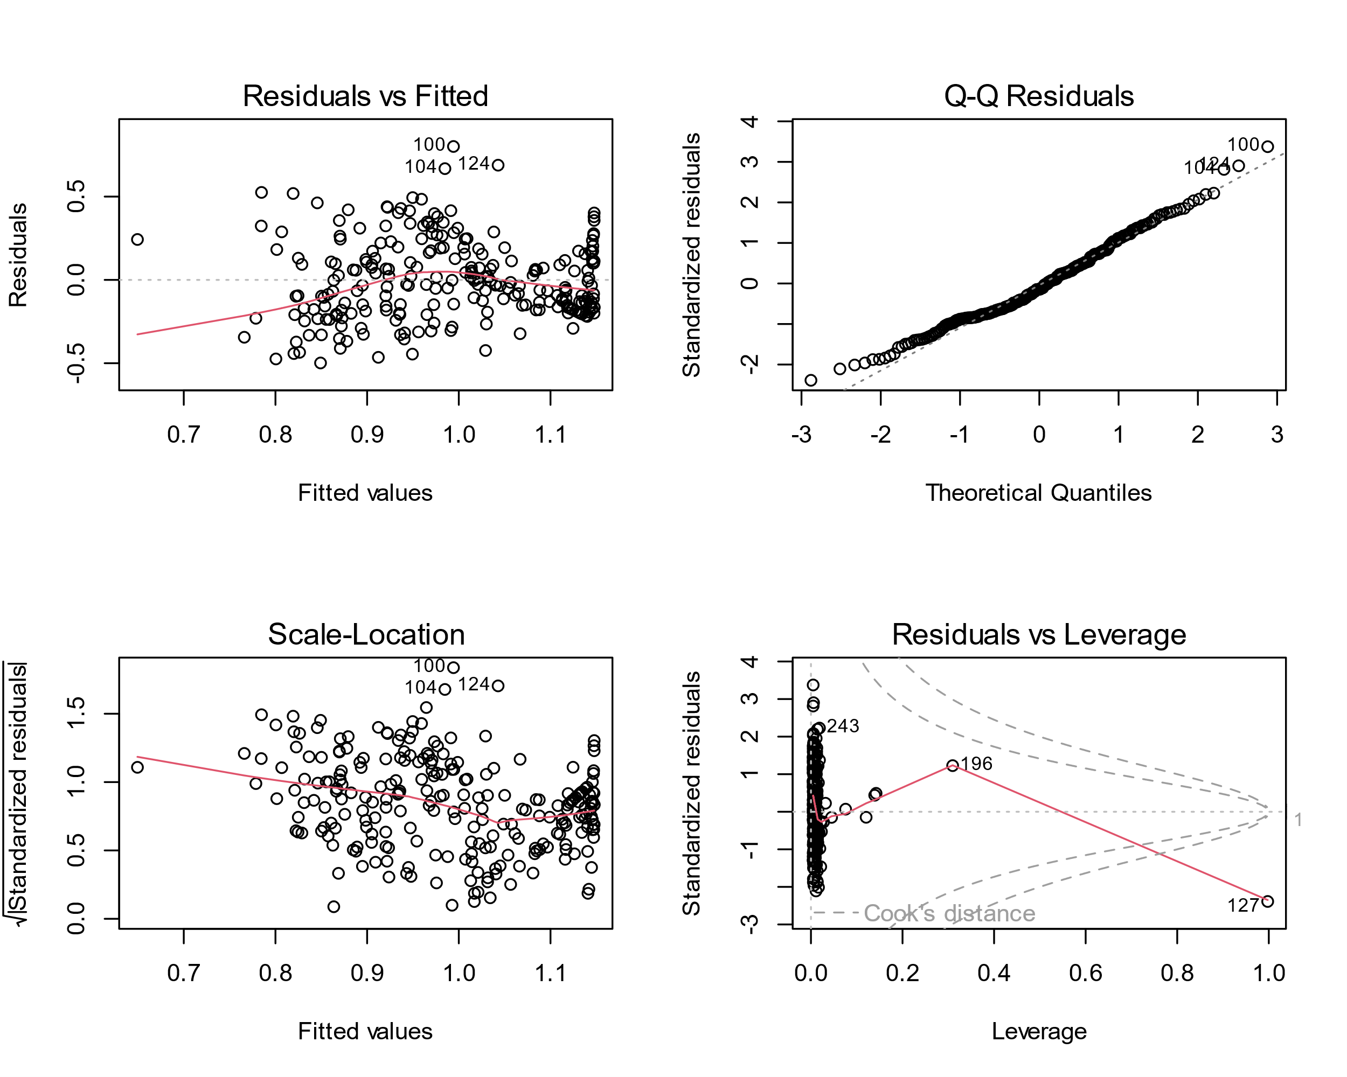
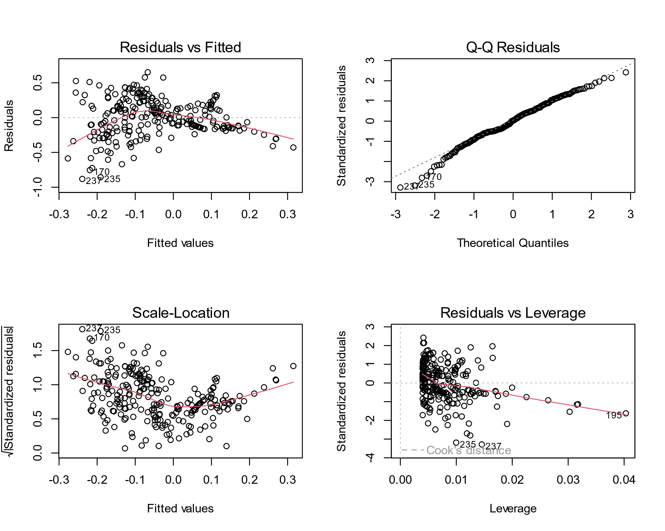
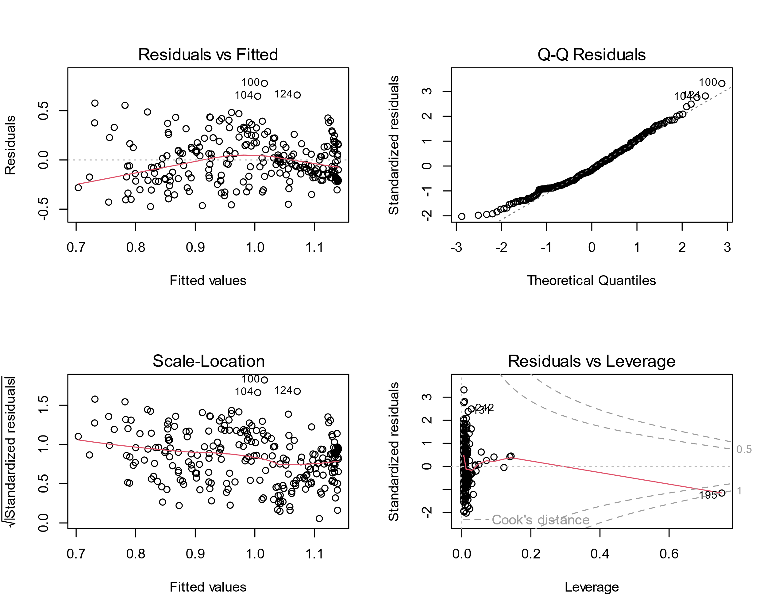
a) Standard Model
c) Log transformed Model
e) Polynomial Model
b) Standard Model (-outlier)
d) Log transformed Model (-outlier)
f) Polynomial Model (-outlier)

